Slide 1
Climate Pollution Meter: Tracking Environmental Impact
BY:
Group 3

Slide 2
Contents
Team Members
Pollution(Introduction)
Why Air Pollution?
Project Importance
Future Possibilities
Data Collected
Wireframes

Slide 3
TEAM MEMBERS
Vivek Sharma - 500225198
Divya Hanspal - 500225305
Jonathan Fred Braganza - 500223773
Ajit Atul Kulkarni - 500223502
Nabila Mansoor - 500223650
Ashtami Vijayan Pillai - 500224260
Rutvik Trivedi - 500223490
Vihar Parekh - 500210512
Jasdeep Kaur Gill - 500224259
Vishruti Avlani - 500224491

Slide 4
Pollution
Pollution is occured when some harmful substance get into the environment through air, water, land, etc. which are unhealthy or unsafe for living beings & can disturb the natural balance.
Mainly, there are 3 kinds of pollution including Air Pollution, Water Pollution & Soil Pollution.
In this project, we will be focusing on Air Pollution by taking pollutant concentration into account & will build a Pollution Meter.

Slide 5
Why Air Pollution??
As we can see that over the years, the concentration of SO2 has increased over the year which is responsible for air pollution.
Due to this, our environment is affected and leads to global warming.
To control these kind of mishap, we have to work towards the way to reduce these emissions.
For that, one of the way is to alert government about the problem so that they can make necessary steps in this path.

Slide 6
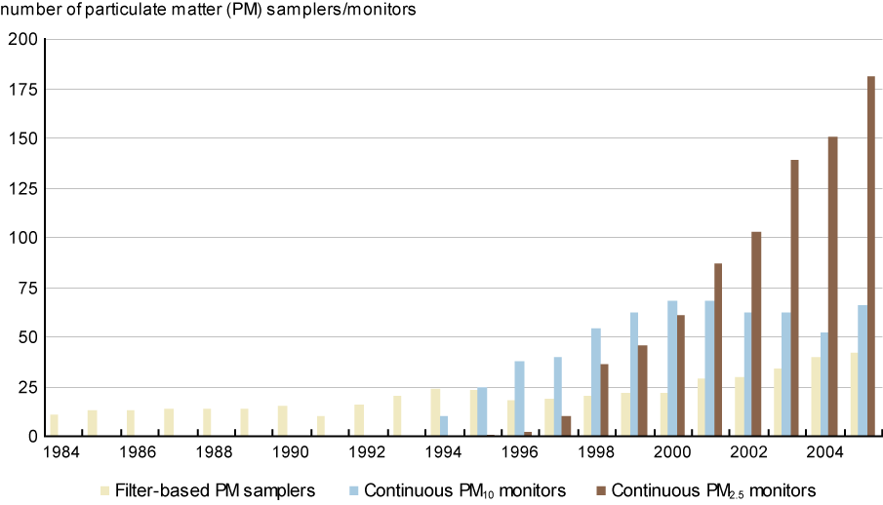

Slide 7
Data Collected
In this project, we will focus on the air pollution data obtained from 6 cities of Ontario Province including Toronto- Downtown, Mississauga, Brampton & Toronto- West, Toronto- East, Toronto- North.
We will look into daily data of various pollutants concentration in air.
There are multiple pollutants responsible for air pollution. Each one of them is harmful for the nature if we’ll not take proper care of it.
Some of the pollutants are Sulphur Dioxide, Nitrogen Oxides, Carbon Monoxide, Ground Level Ozone and Fine Particulate Matter(PM2.5).

Slide 8
Data Collected
The first & foremost step for this project is to collect relevant data which can help in the project.
We have taken the data from government website of Ontario which provide data on Air Quality Index & Air Pollution.
We will work on historical data as well as live data to make the project useful for the government to take required steps to focus on pollutants & pollution.

Slide 9
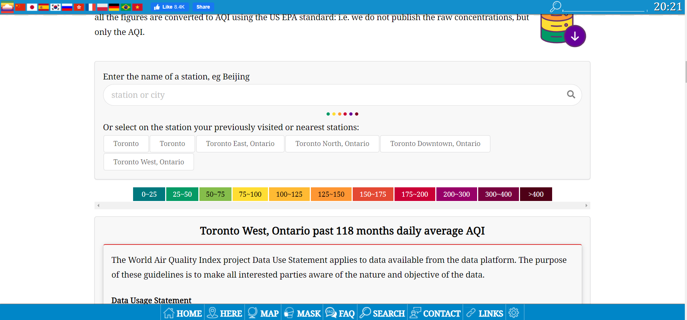
https://aqicn.org/data-platform/register/

Slide 10
WireFrame
There are 4 main component of this project which will work simultaneously with each other.
Data Collection - Data Collection team will work on collecting data from various websites & will try to scrape them.
Data Cleaning - After collecting the data, data cleaning team will focus on removing null & missing values along with the removal of unnecessary data which is of no use.
Model Building & Configuration - Now as the cleared data is obtained, the team will look for building the model on the data with the help of machine learning algorithm.
Data Storing & Front End - Finally the front end department will work on the storing of data provided by the model into the dashboard.

Slide 11
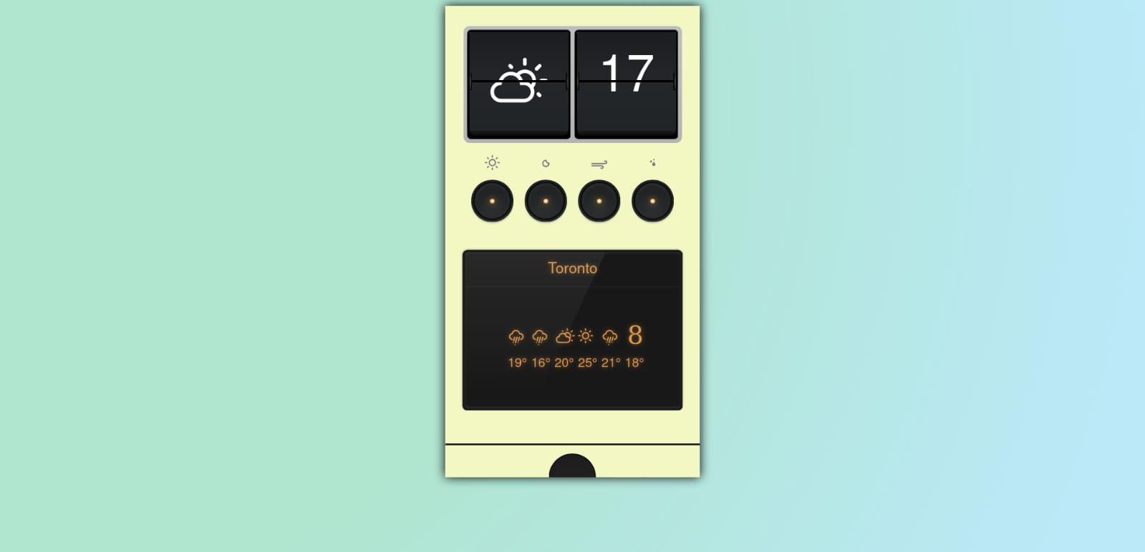
DEMO PROJECT WEBPAGE

Slide 12
References
https://ourworldindata.org/air-pollution-does-it-get-worse-before-it-gets-better
https://www.airqualityontario.com/history/
https://aqicn.org/data-platform/register/

Slide 13
THANK YOU

